Slide 1



September 2023
Enusa in the
nuclear fuel market

Slide 2
Index
State and owned company
Structure of Enusa Group
2022 nuclear fuel main figures and Juzbado factory
First part of the nuclear fuel cycle
Nuclear field activities
Uranium supply
Engineering
On-site fuel services
Waste management and decommisioning
Alliances

Slide 3
State owned company
Texto de ejemplo

Slide 4


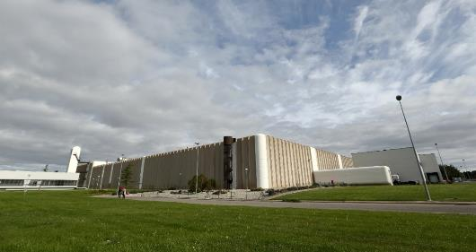
State owned company
60 %
40%
Enusa is a state owned company that was incorporated in 1972 to serve the ambitious Nuclear Power Plant plans.
Business areas:
Nuclear business
Environmental business

Slide 5
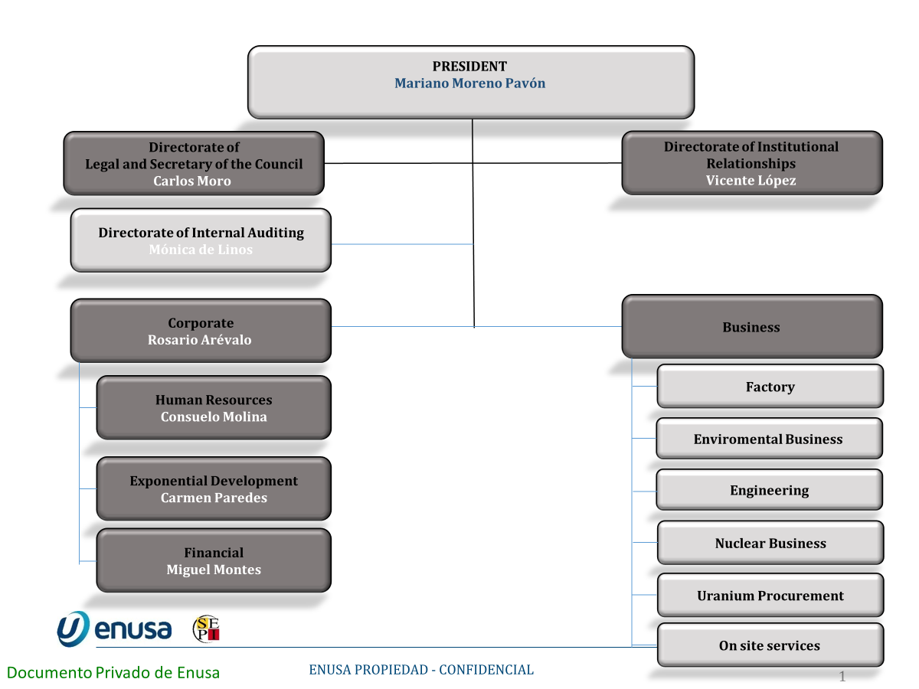
Board of Directors

Slide 6
Structure of Enusa Group
Texto de ejemplo

Slide 7

Enusa Group
RSU CASTELLÓN
85,69%
ETSA
100%
GENUSA
49%
SNGC A.I.E.
25%
OTHER COMPANIES
EMGRISA
99,62%
ENUSA ENSA
A.I.E.
50%
CETRAMESA
10%
REMESA
50%
CETRANSA
30%
GESTIÓN Y PROTECCIÓN AMBIENTAL
100%

Slide 8
2022 nuclear fuel main figures

Slide 9

2022 nuclear fuel main figures
Sales
267,27M€
Profit after tax
3M€
Workers
661 people
Enusa has been able to keep a steady figure of sales and profits during the last years.

Slide 10
2022 nuclear fuel main figures
Licensed capacity
500 tU/year
Authorized enrichment
<5w/o u-235
2022 production
1028 assemblies
448 PWR
580 BWR
More info
282 tons of uranium equivalent (tU) produced
63% of the production was exported to nuclear power plants in France, Sweden, Finland and Belgium.
Accumulative production tU
9.069 tU
27,015 assemblies
15,081 PWR
11,934 BWR
Juzbado facility
Serving the Spanish NPPs since 1985, and in the European Market from the 90s.
Leibstadt was the first NPP in Europe to receive nuclear fuel manufactured at Juzbado.

Slide 11
First part of the nuclear fuel cycle

Slide 12
First part of the nuclear fuel cycle

Slide 13
Nuclear field activities

Slide 14





Nuclear field activities
Uranium supply
The activities in the nuclear field go from the Enriched UF6 procurement and supply to nuclear facilities decommissioning, covering all activities in the nuclear fuel cycle.
Waste management and decommissioning
Design and
engineering
Nuclear business
Spent fuel management
Manufacturing
On-site services
Transport

Slide 15
Engineering

Slide 16
Engineering services
Fuel management and reload core design
Nuclear design & safety analysis
Very wide experience in providing engineering services to European NPPs, covering new fuel introduction, fuel design and licensing, nuclear design, core Monitoring and spent fuel management.
Licensing
New products and technology introduction (R&D)
Spent fuel management & methodologies
Monitoring and support operation

Slide 17
On-site fuel services

Slide 18

On-site fuel services
Fresh fuel handling
Irradiated fuel and core components handling
Leaking fuel inspection
Fuel repair and reconstruction
Fuel inspection and characterization
High efficiency ultrasonic fuel cleaning
Fuel assembly burnup characterization
ENUSA provides high added value on - site services.
ENUSA has developed and owns several characterization and inspection equipments to provide these services to NPPs.

Slide 19
Waste management and decommisioning

Slide 20
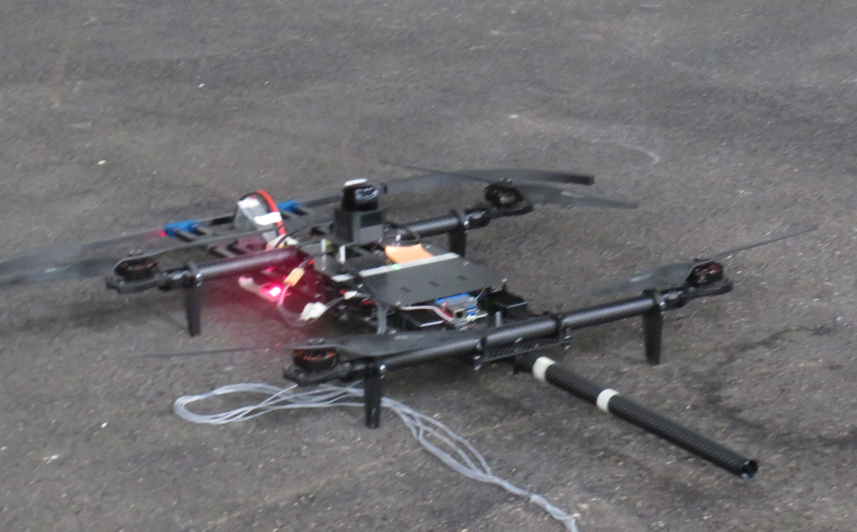
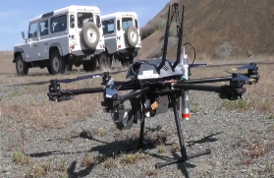
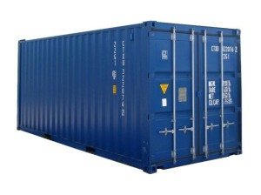
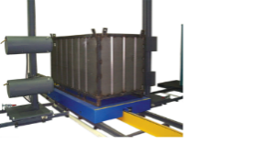

Waste management and decommisioning
1. Radiological characterization
1.1. Drone and detector system for lands and walls characterization
1.2. Drone and detector system for radiological surveillance.
1.3. SISCAREN-RBBA
Improved classification or declassification process.

Slide 21
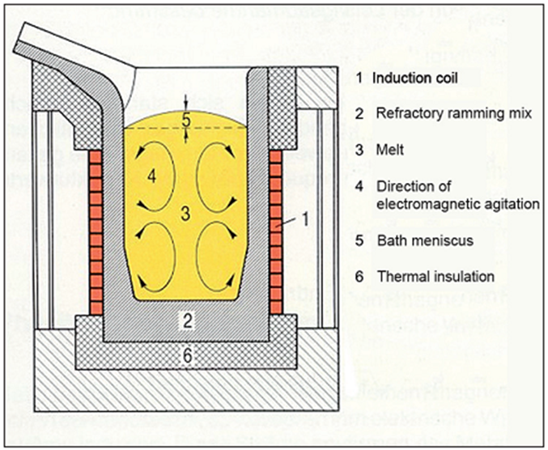

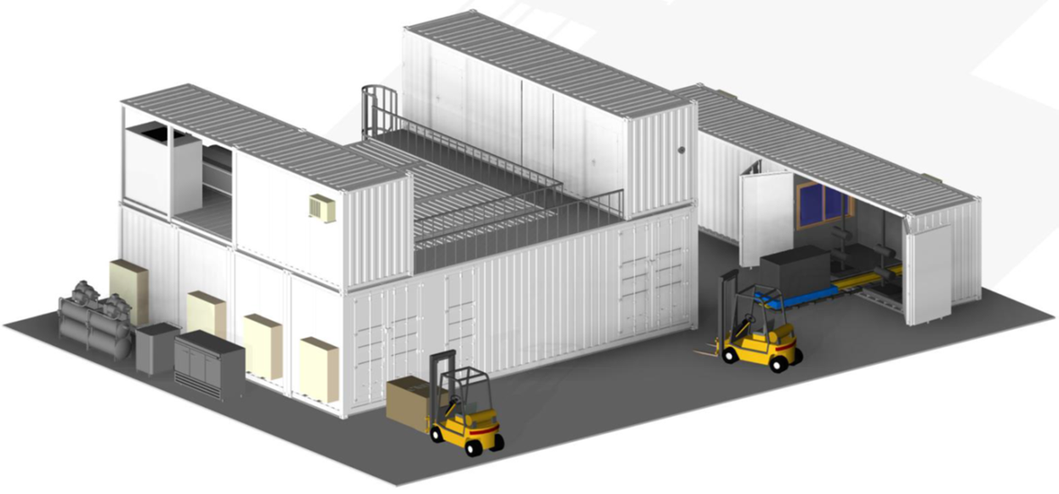
Waste management and decommisioning
2. Waste management
2.1. Laser decontamination
2.2. IPRE
Portable facility for waste management
2.3. Melting furnace
Portable facility for metallic waste

Slide 22
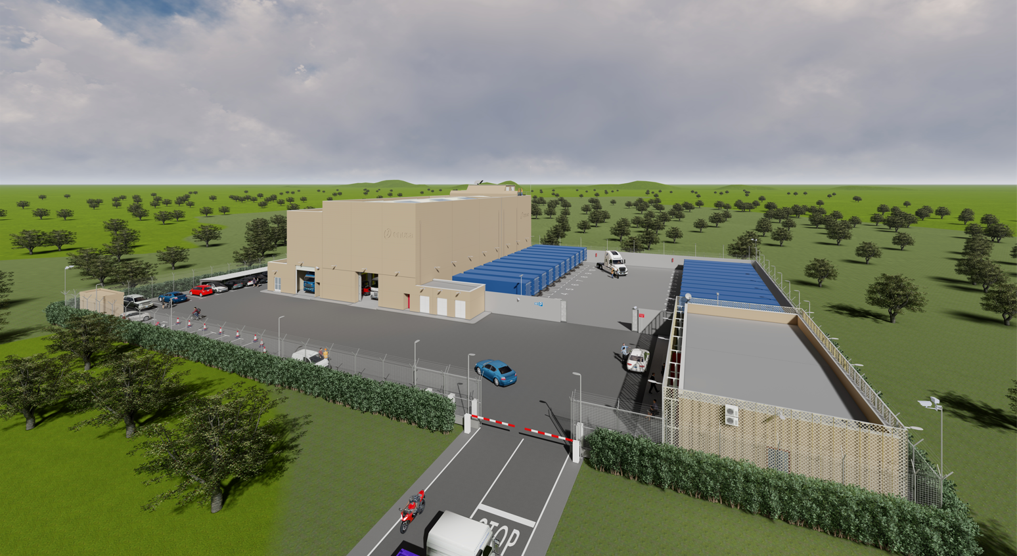
Waste management and decommisioning
3. Centre of Technology and Equipment Maintenance (CTME)
3.1. CTME

Slide 23
Alliances

Slide 24
Technological & strategic alliances
Westinghouse
Commercial agreement
CNNC & CGN
Agreements in China
Enusa A keeps technological alliances with Westinghouse and GN-H/GNF.
Some other potential partners are beign explored.
sa
Genusa
Commercial aliance GNF & Enusa
KNF
Agreement on tecjnology cooperation
Westinghouse
Agreement on technological transfer
GNF
Agreement on technological transfer
SNGC
The economic interest grouping (AIE) constitution between ENSA, TECNATOM, RINGO VALVULAS & Enusa to supply nuclear services

Slide 25
European nuclear fuel customers
TEOLLISUUDEN VOIMA OYJ
Finland
Olkilouto
OKG
Sweden
Oskarshamn
Electrabel
Belgium
Doel 4 Tihange 3
AXPO
Switzerland
Leibstdat
EDF
France
Blayais, Chinon, Gravelines, Saint Laurent, Cruas, Belleville, Paluel, Cattenom, Nogent, Golfech, Penly, Flamanville
ENDESA
IBERDROLA
NATURGY
Spain
Almaraz I & II, Ascó I & II, Vandellós II, Cofrentes, Trillo*
*Only fuel and uranium procurement services are supplied to Trillo nuclear power plant central and in 2016, eight demonstration fuel assemblies (LTAs) by EFC.

